Slide 1
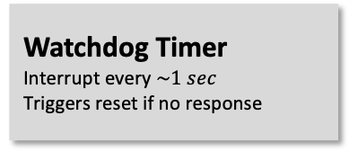
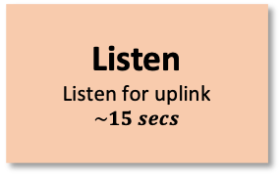

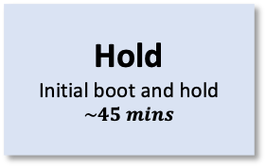
Ground command
Automatic operation
PandaSat CONOPS
Standby
YES
Early Mission Operations
ADCS
Hold
Initial boot and hold
$$\sim 45 mins$$
Deploy Antenna
1) Check battery voltage
2) Deploy Antenna
Detumble
Magnetorquers on
Sleep
Minimal power mode
Batteries charging
YES
Beacon
1) Gather & store data
2) Beacon to ground station
Launch
Deployment from ???
Every $\sim 1 min$
Battery Voltage above Threshold?
Tumbling too fast?
NO
NO
Listen
Listen for uplink
$$\sim 15 secs$$
Payload Operations
Uplink?
Process and Store Data
From payload
NO
YES
Process Uplink
Ability to:
Switch operating mode
Request downlink
Flash from MRAM
NO
Payload On
SDR and Raspberry Pi
YES
NO
Payload Operation Requested?
Downlink Requested?
Watchdog Timer
Interrupt every $\sim 1 sec$
Triggers reset if no response
YES
Downlink
Downlink requested information

